Slide 1
Surf’s up! Process versus product
Barbara Oakley, PhD

Slide 2
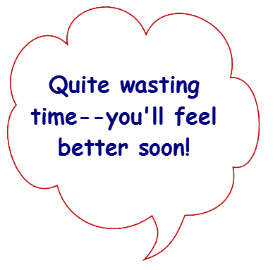
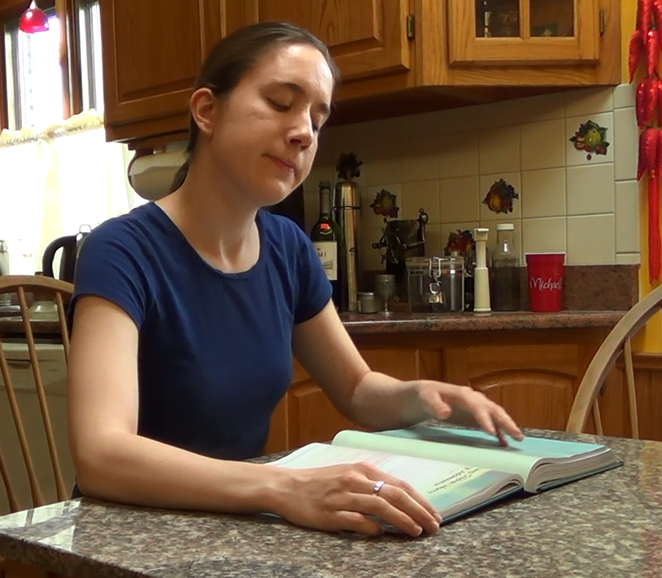
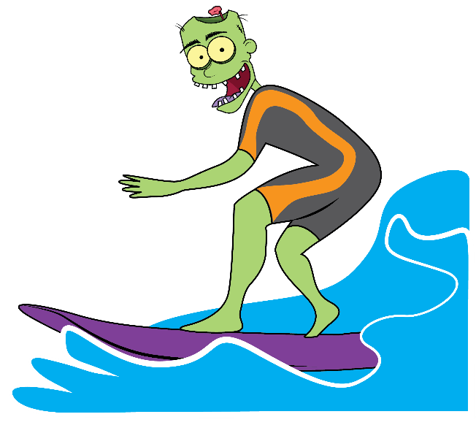
Process
Product

Slide 3
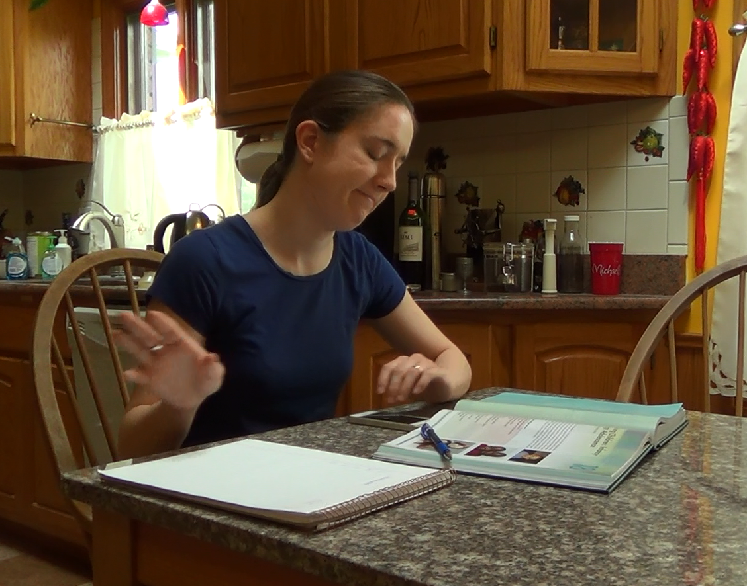

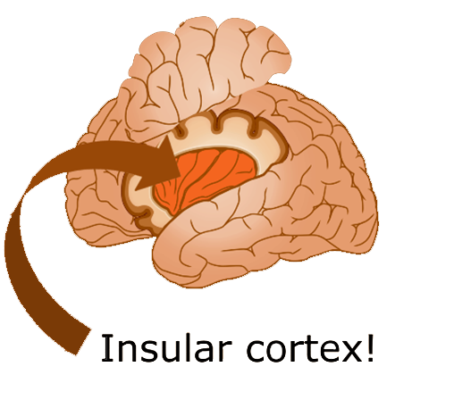
Product
Process

Slide 4
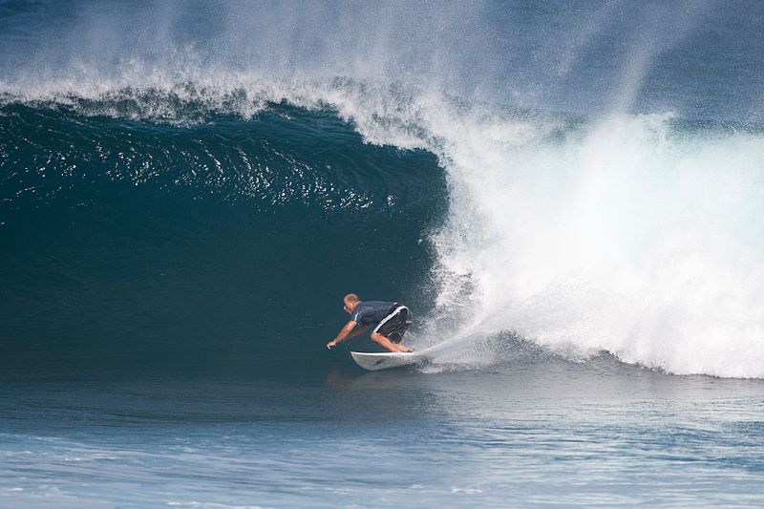

Slide 5
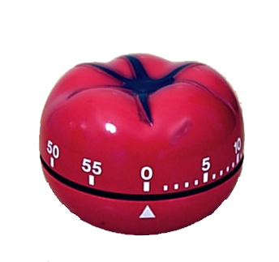
PROCESS
not
product

Slide 6
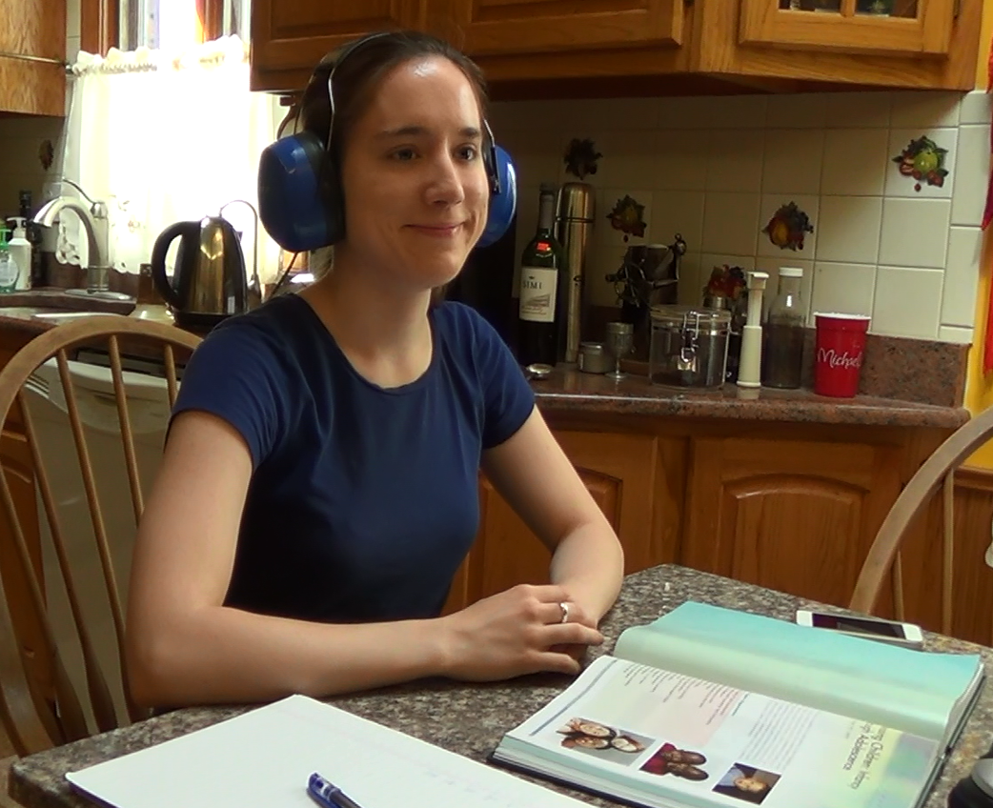

Slide 7
Image Credits
Woman studying courtesy Roslyn Oakley.
Insular cortex ©Kevin Mendez, 2014.
Physicist Antony Garrett Lisi surfing, author Cjean42, http://en.wikipedia.org/wiki/File:Garrett_Lisi_surfing.jpg
Pomodoro timer, Autore: Francesco Cirillo rilasciata a Erato nelle sottostanti licenze seguirÃ OTRS, http://en.wikipedia.org/wiki/File:Il_pomodoro.jpg
Zombie illustrations ©Kevin Mendez, 2014.
Clip art courtesy Microsoft Corporation
Relevant Readings
Boice, Robert. Procrastination and Blocking. Westport, CT: Praeger, 1996.
Duhigg, Charles. The Power of Habit. NY: Random House, 2012.
Ericsson, K Anders, Michael J Prietula, and Edward T Cokely. "The Making of an Expert." Harvard Business Review 85, no. 7/8 (2007): 114.
Fiore, Neil A. The Now Habit. NY: Penguin, 2007.
McClain, Dylan Loeb. "Harnessing the Brain's Right Hemisphere to Capture Many Kings." New York Times, Jan 24 2011.
Steel, Piers. "The Nature of Procrastination: A Meta-Analytic and Theoretical Review of Quintessential Self-Regulatory Failure." Psychological Bulletin 133, no. 1 (Jan 2007): 65-94.
———. The Procrastination Equation. NY: Random House, 2010.
Wan, X., H. Nakatani, K. Ueno, T. Asamizuya, K. Cheng, and K. Tanaka. "The Neural Basis of Intuitive Best Next-Move Generation in Board Game Experts." Science 331, no. 6015 (Jan 21 2011): 341-6.

